Slide 1

Natural Language Processing
Yue Zhang
Westlake University

Slide 2
Overview
Week 2
Overview of NLP architecture
Data and Model
Review of background
Linear Models
Week 3
Week 4
Week 5
Week 6
Week 7
N-gram Language Models
Naïve Bayes
Generative Text Classification
Features
Document Representation
Discriminative Text Classification
Neuron
SGD
Entropy, Perplexity
Word Representation
HMM -- Generative Sturctured Prediction
CRF – Discriminative Structured Prediction
Neural Models
Week 8
Week 10
Week 12
MLP, Multi-Layer Perception
Neural N-gram LM and Word Embedding
Neural Structured Prediction
Sequence-to-sequence
Neural Recurrent Language Models
Week 9
Week 13
Sequence Representation
Neural Text Classification
Week 11
Sequence-level Pre-training
Pre-trained Models for Text Classification and other MLP tasks
Structured Representation
Large Language Models
Week 14
Week 15
Scaling, instruction following and LLMs
LLMs for NLP, AGI and beyond

Slide 3
Week 10
Neural Structured Prediction

Slide 4
Goals
Structured prediction tasks
More details on representation

Slide 5
Contents
10.1 Local Graph-Based Models
10.1.1 Sequence labelling
10.1.2 Dependency Parsing
10.1.3 Constituent Parsing
10.2 Local Transition-Based Models
10.2.1 Model 1
10.2.2 Model 2
10.2.3 Model 3
10.3 Global Structured Models

Slide 6
Contents
10.1 Local Graph-Based Models
10.1.1 Sequence labelling
10.1.2 Dependency Parsing
10.1.3 Constituent Parsing
10.2 Local Transition-Based Models
10.2.1 Model 1
10.2.2 Model 2
10.2.3 Model 3
10.3 Global Structured Models

Slide 7
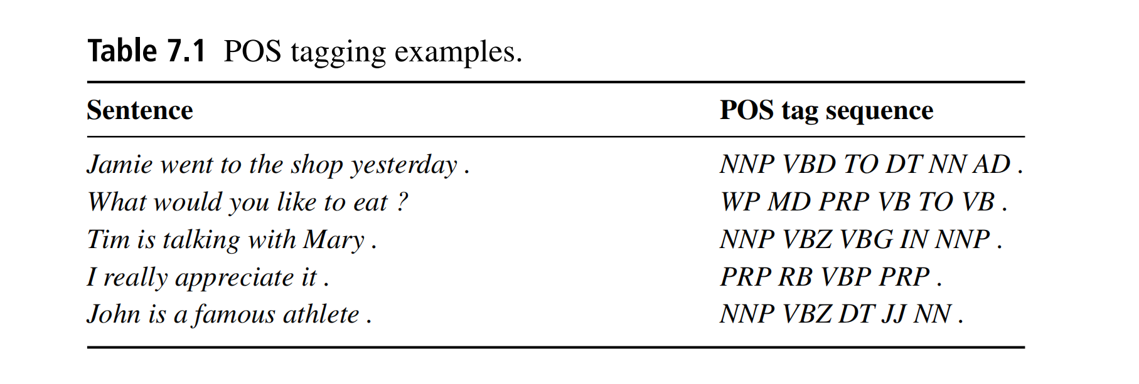
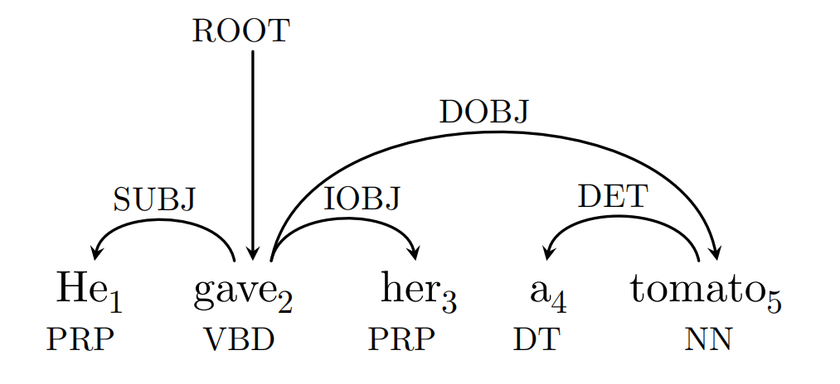
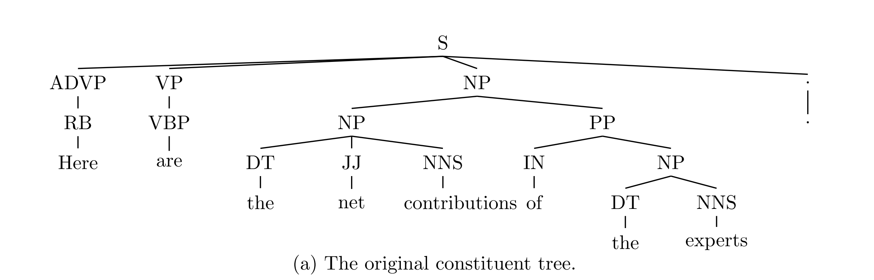
Structure Prediction
POS - tagging
Depending parsing
Constituent parsing

Slide 8
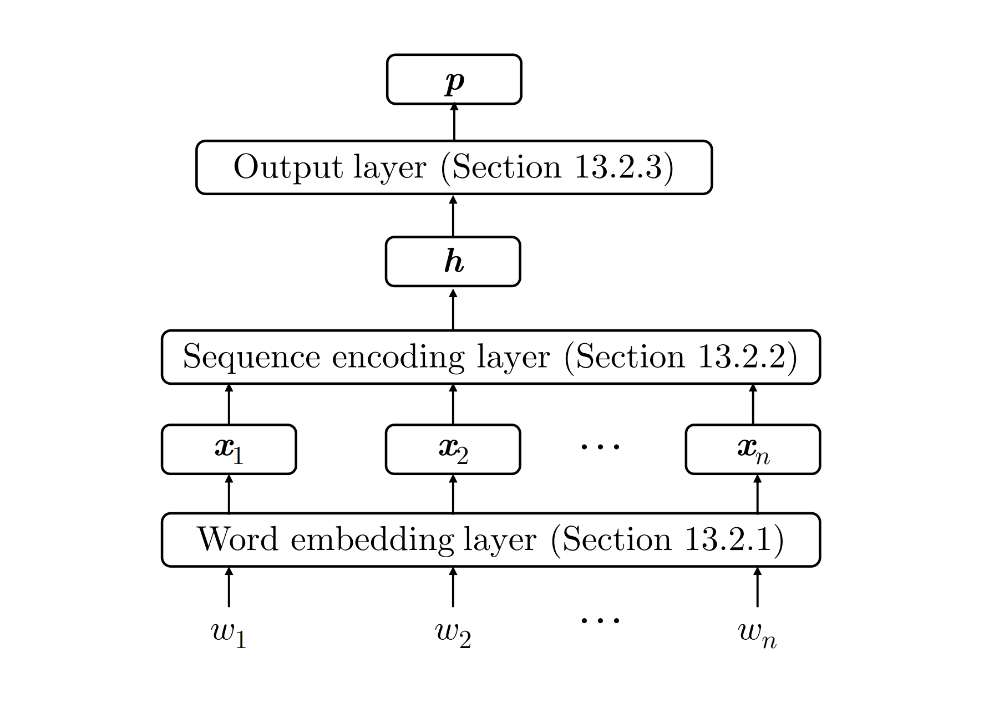
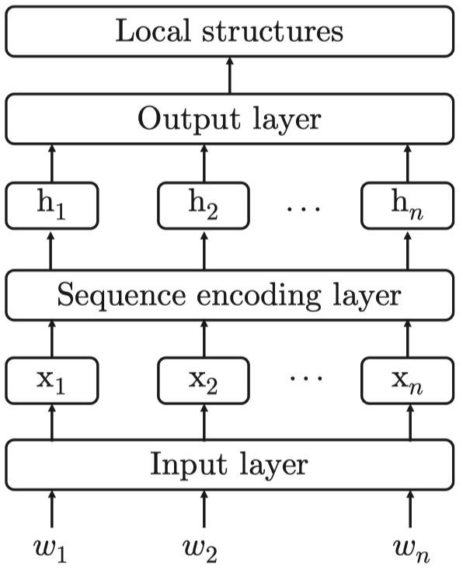
Neural Models

Slide 9
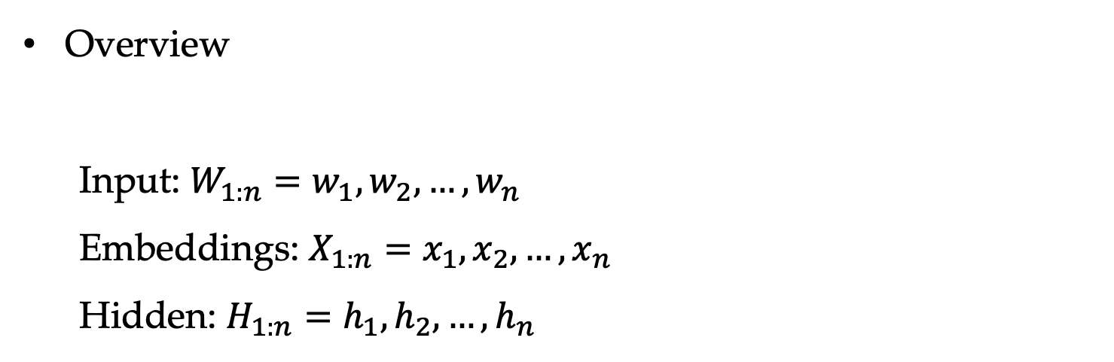
Neural Models
Overview
Input: $W_{1:n}=w_{1},w_{2},…,w_{n}$
Embeddings: $X_{1:n}=x_{1},x_{2},…,x_{n}$
Hidden: $H_{1:n}=h_{1},h_{2},…,h_{n}$
build local structures.
Called graph-based models because of predicting structures directly.

Slide 10
Contents
10.1 Local Graph-Based Models
10.1.1 Sequence labelling
10.1.2 Dependency Parsing
10.1.3 Constituent Parsing
10.2 Local Transition-Based Models
10.2.1 Model 1
10.2.2 Model 2
10.2.3 Model 3
10.3 Global Structured Models

Slide 11
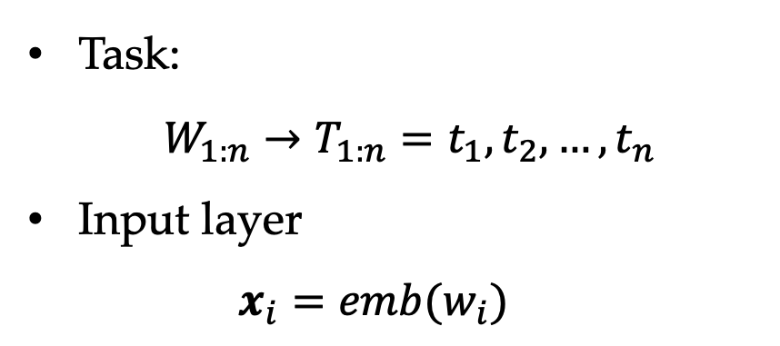
Sequence Labelling
Task:
$W_{1:n}→T_{1:n}=t_{1},t_{2},…,t_{n}$
Input layer
$x_{i}=emb(w_{i})$

Slide 12
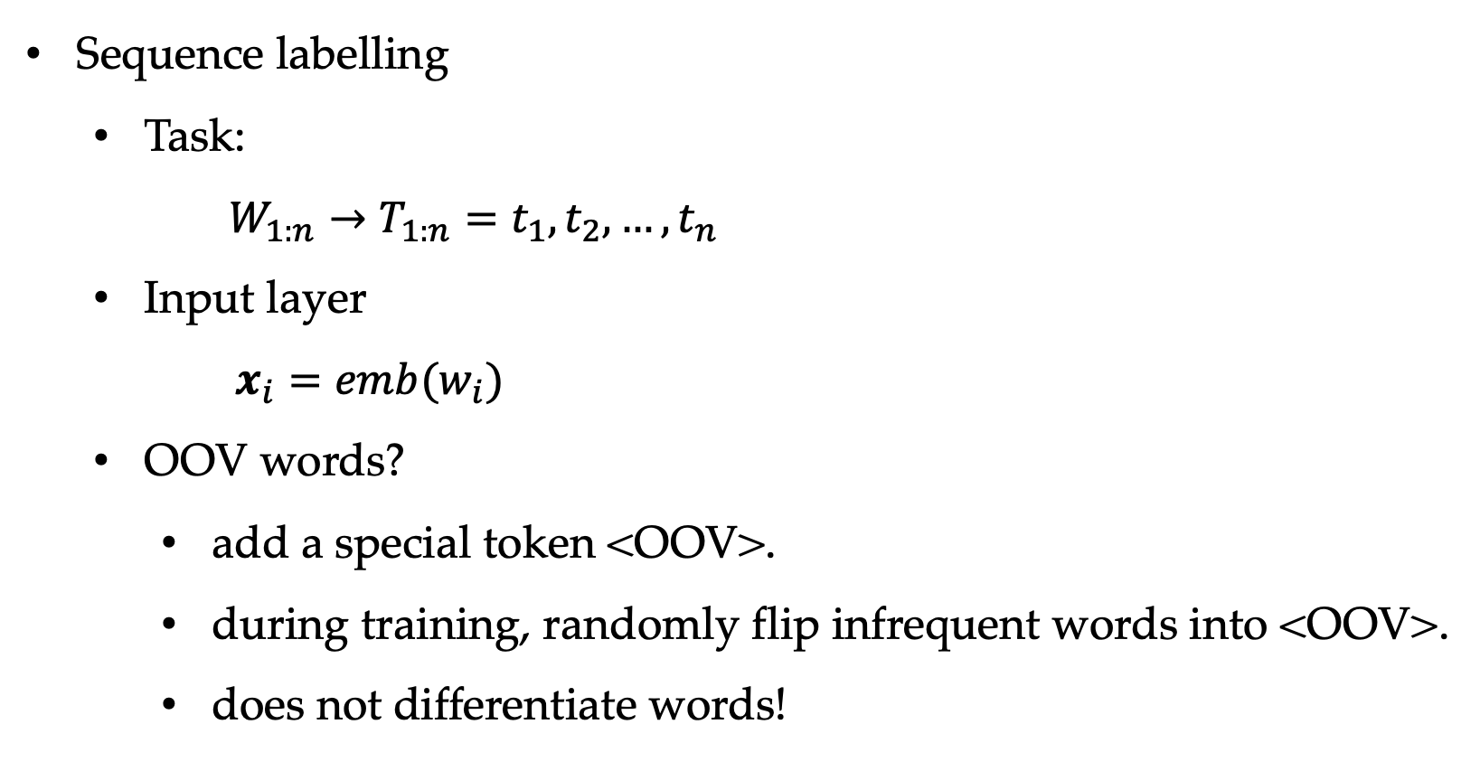
Sequence Labelling
Sequence labelling
Task:
$W_{1:n}→T_{1:n}=t_{1},t_{2},…,t_{n}$
Input layer
$x_{i}=emb(w_{i})$
OOV words?
add a special token <OOV>.
during training, randomly flip infrequent words into <OOV>.
does not differentiate words!

Slide 13
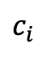
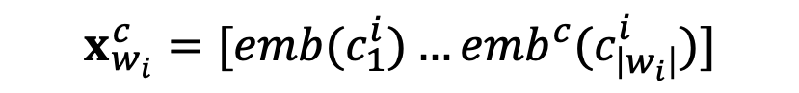


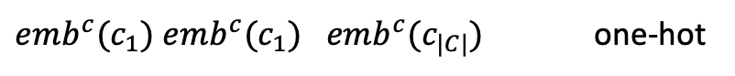


Character Embedding
Input layer
$$w_{i}=C_{1:\left|w_{i}\right|}=c_{1}^{i},c_{2}^{i},…,c_{\left|w_{i}\right|}^{i}$$
$$x_{w_{i}}^{c}=[emb(c_{1}^{i})…emb^{c}(c_{\left|w_{i}\right|}^{i})]$$
…
…
…
…
$$×$$
$$c_{i}$$
$$chr\left(w_{i}\right)=Encoder\left(x_{w_{i}}^{c}\right)$$
$$x_{i}=chr\left(w_{i}\right)⊕emb\left(w_{i}\right)$$
$emb^{c}(c_{1})$ $emb^{c}(c_{1})$ $emb^{c}(c_{|C|})$ one-hot

Slide 14
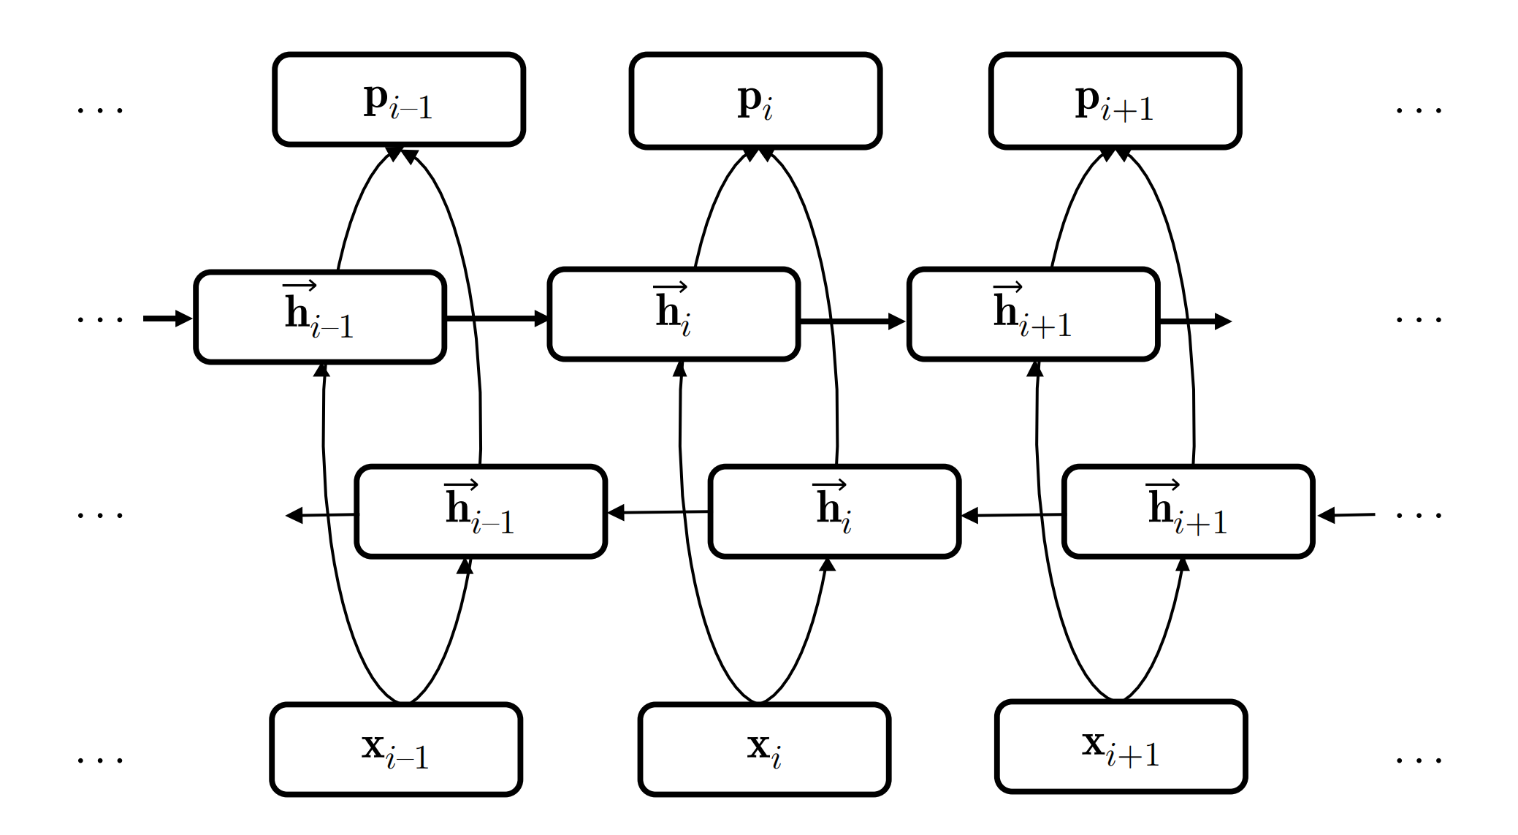

Sequence Encoding
Sequence labelling
Sequence representation layer
Can stack multi layers.
$$H_{1:n }=BiLSTM\left(X_{1:n}\right)$$

Slide 15
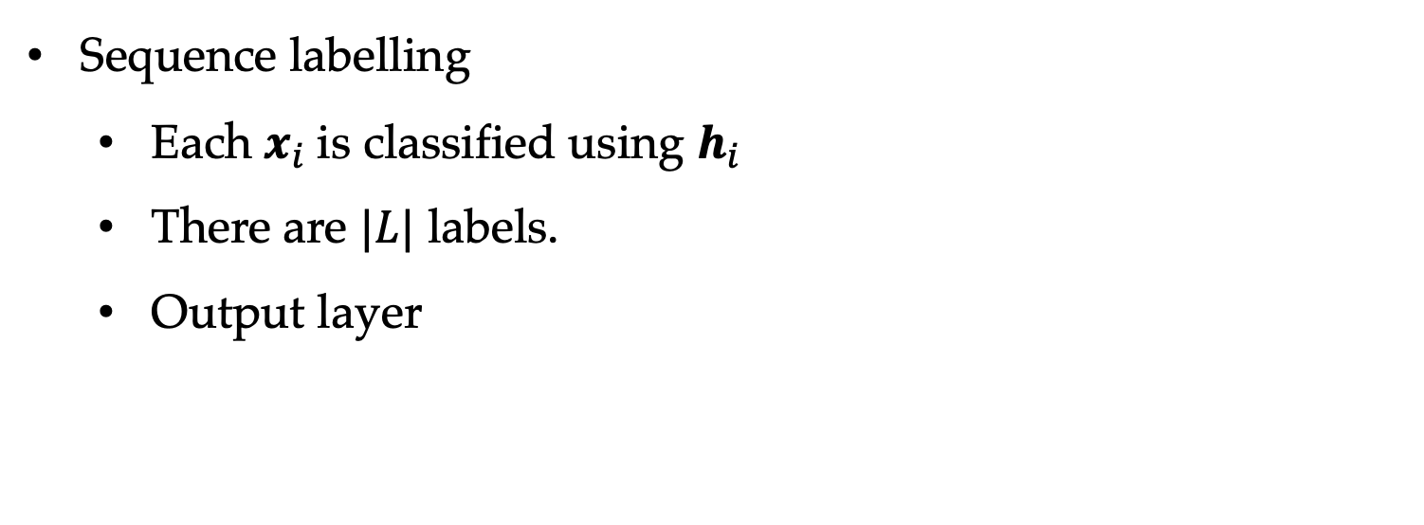
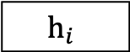
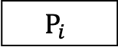
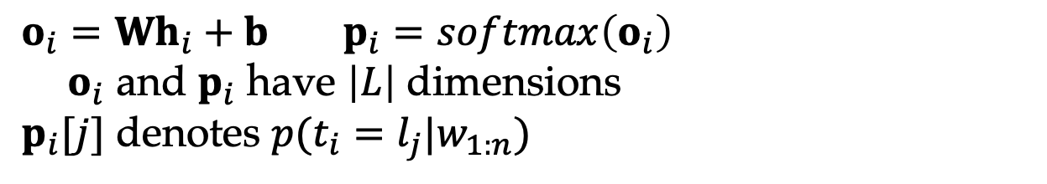
Output Layer
Sequence labelling
Each $x_{i}$is classified using $h_{i}$
There are $|L|$ labels.
Output layer
$$P_{i}$$
$$h_{i}$$
$$o_{i}=Wh_{i}+b p_{i}=softmax\left(o_{i}\right)$$
${ o}_{i}$ and $p_{i}$ have $\left|L\right|$ dimensions
$p_{i}[j]$ denotes $p(t_{i}=l_{j}|w_{1:n})$
Notes:
Why large margin model not work for neural networks
A graph to illustrating gradients propogation

Slide 16
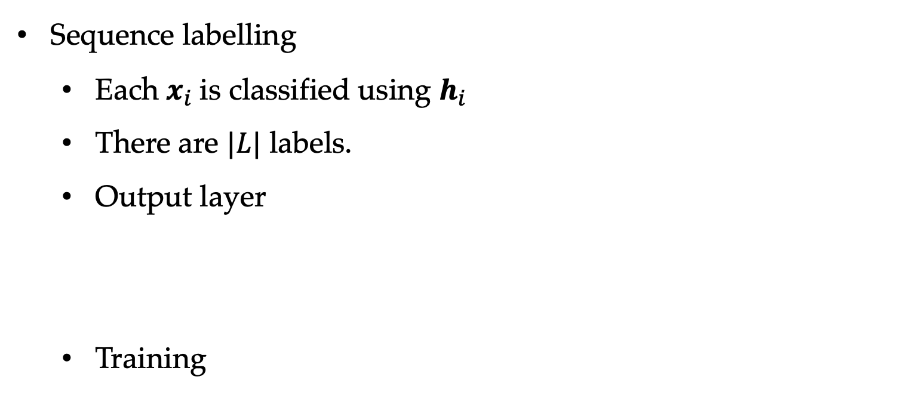
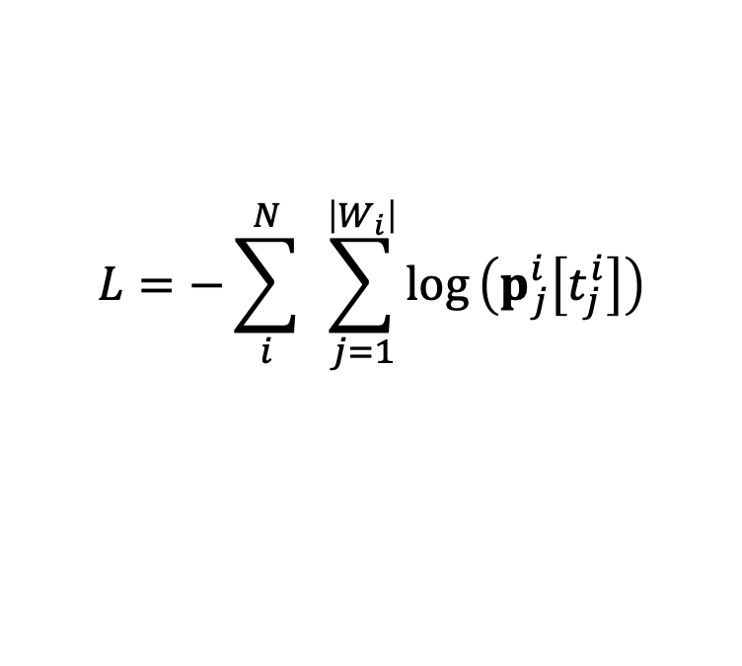

Output Layer
Sequence labelling
Each $x_{i}$is classified using $h_{i}$
There are $|L|$ labels.
Output layer
Training
$$P_{i}$$
$$h_{i}$$
$$o_{i}=Wh_{i}+b p_{i}=softmax\left(o_{i}\right)$$
${ o}_{i}$ and $p_{i}$ have $\left|L\right|$ dimensions
$p_{i}[j]$ denotes $p(t_{i}=l_{j}|w_{1:n})$
$$D=\left\{\left(W_{i} , T_{i}\right)\right\}{\left.|\right.}_{i=1}^{N}$$
$$L=−\sum_{i}^{N}{ }\sum_{j=1}^{\left|W_{i}\right|}{log}\left(p_{j}^{i}\left[t_{j}^{i}\right]\right)$$
Notes:
Why large margin model not work for neural networks
A graph to illustrating gradients propogation

Slide 17
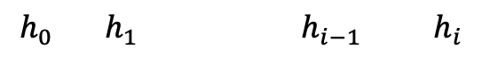
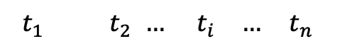
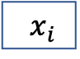
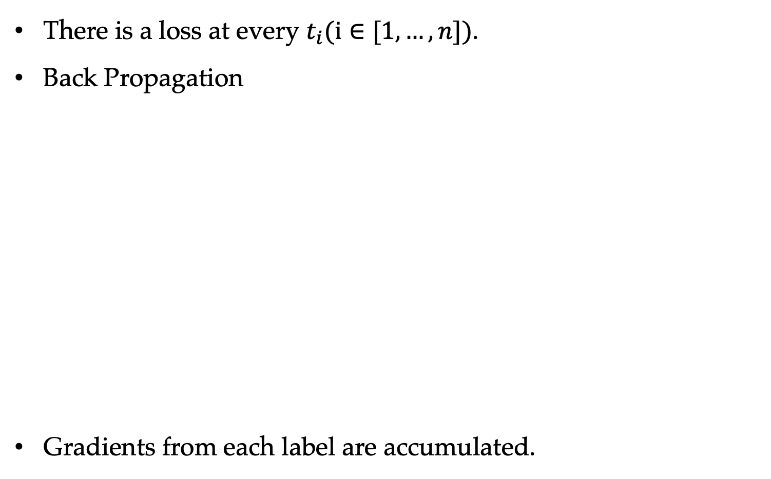
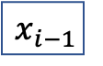
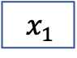
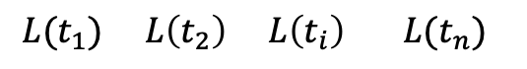
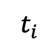
Training
There is a loss at every $t_{i}(i∈[1,…,n])$.
Back Propagation
Gradients from each label are accumulated.
$$t_{1} t_{2 }… { t}_{i} … t_{n}$$
$${L(t}_{1}) L\left(t_{2}\right) L\left(t_{i}\right) L(t_{n})$$
BiLSTM
$$t_{i}$$
…
$$h_{0} h_{1} h_{i−1 } h_{i}$$
$$x_{1}$$
$$x_{i−1}$$
$$x_{i}$$

Slide 18
Why Local Model Works?
HMM and CRF learn tag sequences globally
Neural model treats each tag individually.
BiLSTM implicitly learns abstract structural features in sequence labeling.

Slide 19
Contents
10.1 Local Graph-Based Models
10.1.1 Sequence labelling
10.1.2 Dependency Parsing
10.1.3 Constituent Parsing
10.2 Local Transition-Based Models
10.2.1 Model 1
10.2.2 Model 2
10.2.3 Model 3
10.3 Global Structured Models

Slide 20
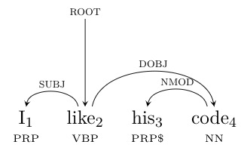
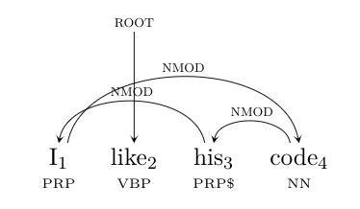
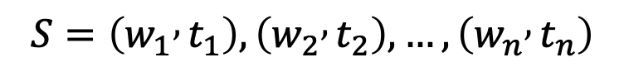
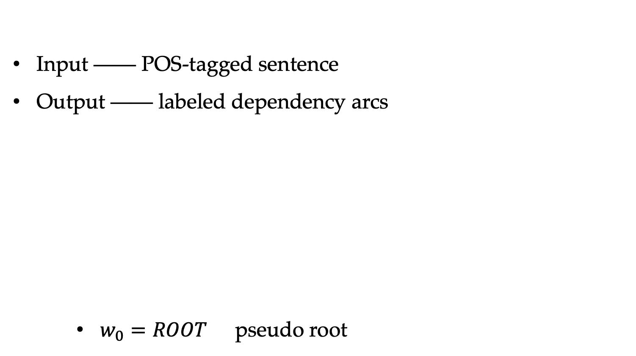

Dependency Parsing
Input —— POS-tagged sentence
Output —— labeled dependency arcs
$w_{0}=ROOT$ pseudo root
$$S=\left(w_{1} , t_{1}\right),\left(w_{2} , t_{2}\right),…,\left(w_{n} , t_{n}\right)$$
$$o=\left\{\left(i , h_{i} , l_{i}\right)\right\}{\left.|\right.}_{i=1}^{n}$$
projective tree
incorrect tree

Slide 21
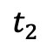
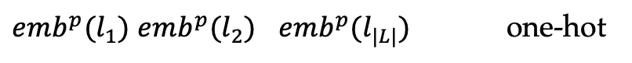
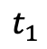
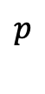

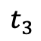
Input Representation
Dependency parsing
Input layer
POS embedding
$$x_{i}=emb\left(w_{i}\right)⊕chr\left(w_{i}\right)⊕emb^{p}\left(t_{i}\right)$$
…
…
…
…
$$×$$
$$p$$
$$t_{1}$$
$$t_{2}$$
$$t_{3}$$
$emb^{p}(l_{1})$ $emb^{p}(l_{2})$ $emb^{p}(l_{|L|})$ one-hot

Slide 22


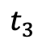
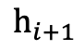
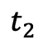
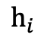
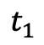
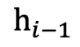
Sequence Encoding
Dependency parsing
Sequence encoding layer
$$H_{1:n }=BiLSTM\left(X_{1:n}\right)$$
$$h_{i−1}$$
$$h_{i}$$
$$h_{i+1}$$
$$t_{1}$$
$$t_{2}$$
$$t_{3}$$

Slide 23
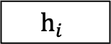
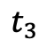

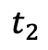
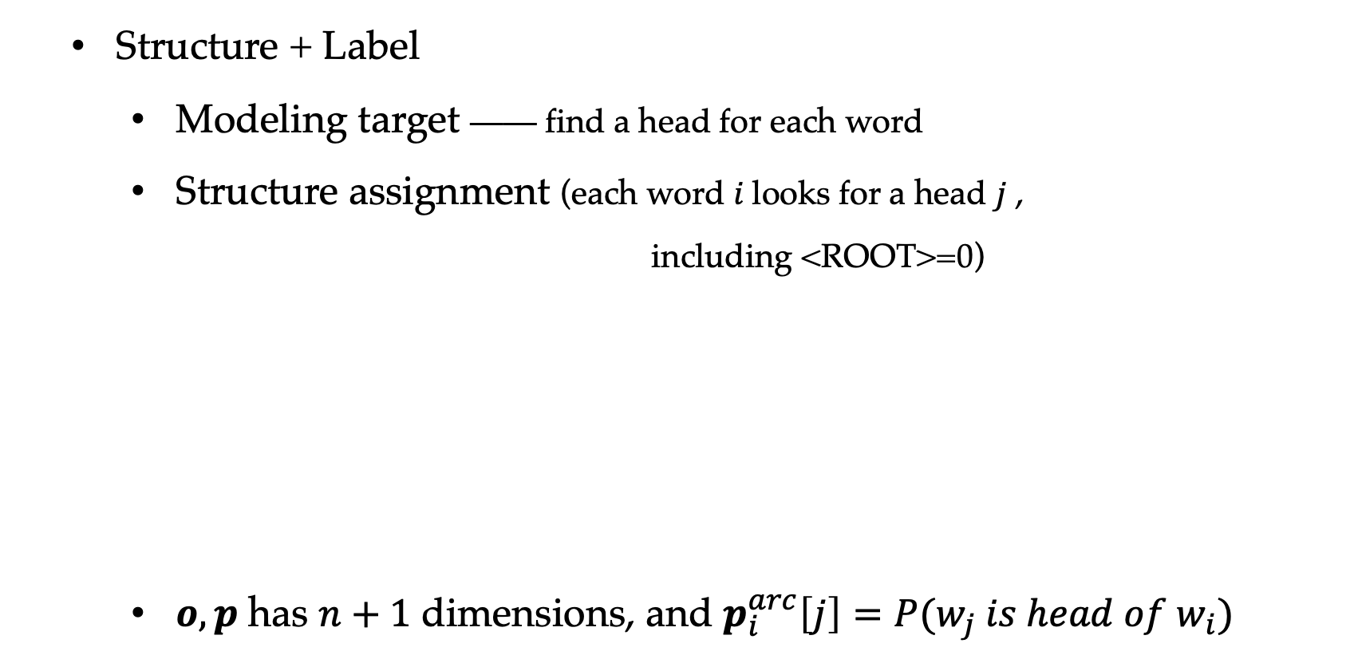

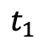

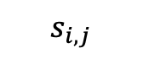
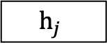
Output Layer
Structure + Label
Modeling target —— find a head for each word
Structure assignment (each word $i$looks for a head $j$ ,
including <ROOT>=0)
$o,p$ has $n+1$ dimensions, and $p_{i}^{arc}\left[j\right]=P(w_{j} is head of w_{i})$
$$s_{i,j}=h_{i}^{T}Uh_{j}+v^{T}\left(h_{i}⨁h_{j}\right)$$
$$s_{i,j}$$
$$o_{i}^{arc}=〈s_{i,1} , s_{i,2} , … , s_{i,n}〉$$
$$h_{i}$$
$$h_{j}$$
$$p_{i}^{arc}=softmax\left(o_{i}^{arc}\right)$$
$$h_{i}=\underset{h}{argmax}p_{i}^{arc}\left[h\right]$$
$$t_{1}$$
$$t_{2}$$
$$t_{3}$$

Slide 24

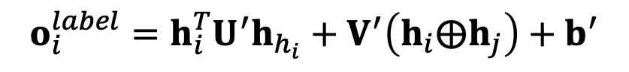
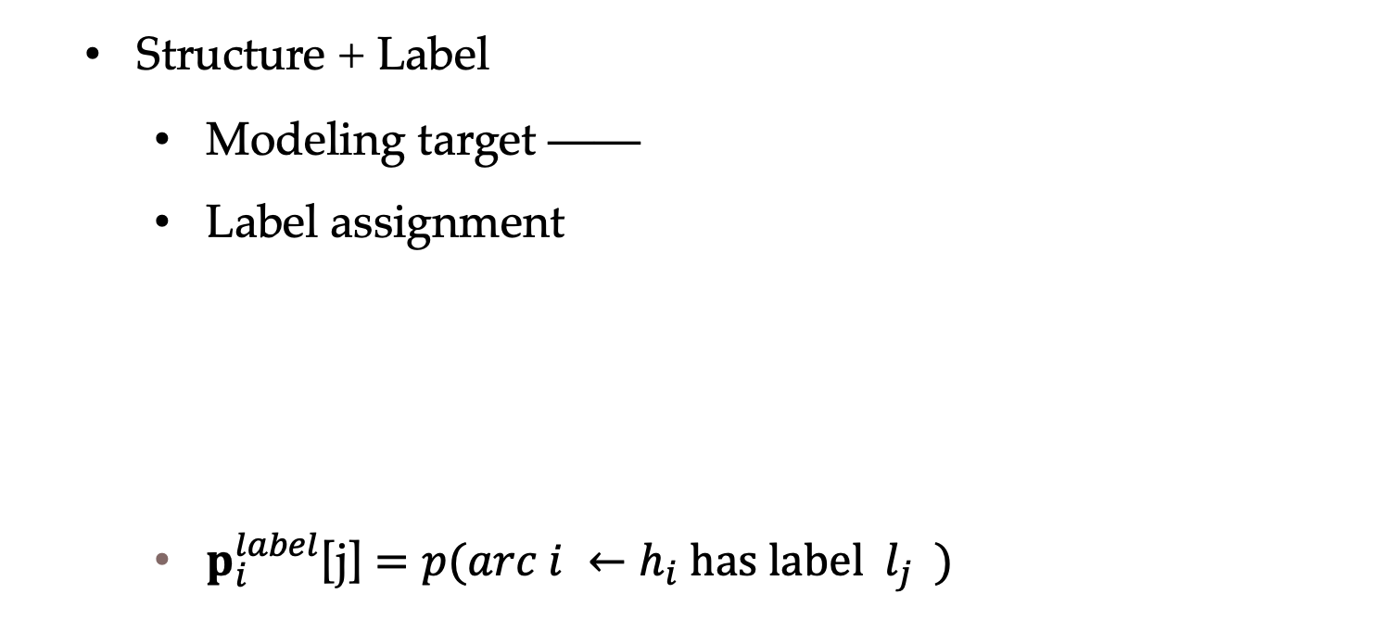




Output Layer
Structure + Label
Modeling target ——
Label assignment
$p_{i}^{label}$[j] $=p(arc i ←h_{i} has label l_{j} )$
find a class label given
a head-dependent pair.
$$o_{i}^{label}=h_{i}^{T}U^{′}h_{h_{i}}+V^{′}\left(h_{i}⨁h_{j}\right)+b^{′}$$
$$l_{i,j}$$
$$p_{i}^{label}=softmax\left(o_{i}^{label}\right)$$
$$h_{i}$$
$$h_{j}$$
$$t_{1}$$
$$t_{2}$$
$$t_{3}$$

Slide 25




Training
Dependency parsing
Training
Loss from every arc accumulates via $h_{i}, h_{j}$
Loss from every arc label accumulates via $h_{i},h_{j}$
$$D=\left\{\left(S_{i} , T_{i}\right)\right\}{\left.|\right.}_{i=1}^{N}$$
$$T_{i}=\left\{\left(j , h_{j}^{i} , l_{j}^{i}\right)\right\}{\left.|\right.}_{j=1}^{\left|S_{i}\right|}$$
$$L=−\sum_{i}^{N}{ }\sum_{j=1}^{\left|W_{i}\right|}{ }\left(log\left({\left(p_{j}^{i}\right)}^{arc}\left[h_{j}^{i}\right]\right)+log\left({\left(p_{j}^{i}\right)}^{label}\left[l_{j}^{i}\right]\right)\right)$$

Slide 26
Decoding
Results in invalid tree?
Use a dynamic program —— MST.
I like his code

Slide 27
Contents
10.1 Local Graph-Based Models
10.1.1 Sequence labelling
10.1.2 Dependency Parsing
10.1.3 Constituent Parsing
10.2 Local Transition-Based Models
10.2.1 Model 1
10.2.2 Model 2
10.2.3 Model 3
10.3 Global Structured Models

Slide 28




Constituent Parsing
Task
Input
Output
Local model predicts each span separately.
$$S=\left(w_{1} , t_{1}\right),\left(w_{2} , t_{2}\right),…,\left(w_{n} , t_{n}\right)$$
$$cεL$$
$$T=\left\{(b,e,c)\right\}, 1≤b≤e≤n,$$
e.g., (3, 4, NP), (2, 4, VP), (1, 4, S)

Slide 29
Constituent Parsing
Task
Input
Output
Local model predicts each span separately.
$$S=\left(w_{1} , t_{1}\right),\left(w_{2} , t_{2}\right),…,\left(w_{n} , t_{n}\right)$$
$$cεL$$
$$T=\left\{(b,e,c)\right\}, 1≤b≤e≤n,$$
e.g., (3, 4, NP), (2, 4, VP), (1, 4, S)

Slide 30



Constituent Parsing
Modeling target
$$(1, 3, φ)$$
I like his
1 2 3
$$VP$$
$$(2, 4, VP)$$
like his code
2 3 4

Slide 31



Constituent Parsing
Input layer —— given word-tag sequences
$$\begin{matrix}chr\left(w_{i}\right)=tanh\left(W_{e}^{char}ch_{i}^{l}+W_{r}^{char}ch_{i}^{r}+b^{char}\right) \\ x_{i}=emb\left(w_{i}\right)⊕chr\left(w_{i}\right)⊕emb^{p}\left(t_{i}\right)\end{matrix}$$
$$t_{1}$$
$$t_{2}$$
$$t_{3}$$

Slide 32

Constituent Parsing
Input layer —— given word-tag sequences
$$\begin{matrix}chr\left(w_{i}\right)=tanh\left(W_{e}^{char}ch_{i}^{l}+W_{r}^{char}ch_{i}^{r}+b^{char}\right) \\ x_{i}=emb\left(w_{i}\right)⊕chr\left(w_{i}\right)⊕emb^{p}\left(t_{i}\right)\end{matrix}$$
Sequence encoding layer (stacked bi-LSTM)
$$\left.\left.s\left.[\right.b,e]\right.=h_{b}⊕h_{e}\right.$$
(quadratic)
$$t_{1}$$
$$t_{2}$$
$$t_{3}$$

Slide 33






Constituent Parsing
Input layer —— given word-tag sequences
$$\begin{matrix}chr\left(w_{i}\right)=tanh\left(W_{e}^{char}ch_{i}^{l}+W_{r}^{char}ch_{i}^{r}+b^{char}\right) \\ x_{i}=emb\left(w_{i}\right)⊕chr\left(w_{i}\right)⊕emb^{p}\left(t_{i}\right)\end{matrix}$$
Sequence encoding layer (stacked bi-LSTM)
$$\left.\left.s\left.[\right.b,e]\right.=h_{b}⊕h_{e}\right.$$
Output layer
$$\begin{matrix}h\left[b , e\right]=tanh\left(W^{h}s\left[b , e\right]+b^{h}\right) \\ o\left[b , e\right]=W^{o}h\left[b , e\right]+b^{o} \\ p\left[b , e\right]=softmax\left(o\left[b , e\right]\right)\end{matrix}$$
$$t_{1}$$
$$t_{2}$$
$$t_{3}$$

Slide 34


Decoding
Find structure first
Find label on structure
Invalid tree? $⇒$ CKY
$$\begin{matrix}P\left(y | = | 1 | Sbe\right)=\sum_{c,c≠φ}{P\left(c | S | b | e\right)} \\ P\left(y | = | 0 | Sbe\right)=P\left(φ | S | b | e\right)\end{matrix}$$

Slide 35





Training
$$D=\left\{\left(S_{i} , T_{i}\right)\right\}{\left.|\right.}_{i=1}^{N}$$
$$\begin{matrix} \\ S_{i}=\left(w_{1}^{i} , t_{1}^{i}\right),…,\left(w_{\left|S_{i}\right|}^{i} , t_{\left|S_{i}\right|}^{i}\right) \\ T_{i}=\left\{〈b_{k}^{i} , e_{k}^{i} , l_{b_{k}^{i}.e_{k}^{i}}^{i}〉\right\}{\left.|\right.}_{k=1}^{\left|T_{i}\right|} \\ \end{matrix}$$
$c=l_{b,e} if \left(b,e,c\right)∈T_{i}$ and $φ$ otherwise.
$$L=−\sum_{i=1}^{N}{ }\sum_{1≤b≤\left|S_{i}\right|,b≤e≤\left|S_{i}\right|}{logP\left(c | S | b | e\right)}$$
$$t_{1}$$
$$t_{2}$$
$$t_{3}$$

Slide 36
Contents
10.1 Local Graph-Based Models
10.1.1 Sequence labelling
10.1.2 Dependency Parsing
10.1.3 Constituent Parsing
10.2 Local Transition-Based Models
10.2.1 Model 1
10.2.2 Model 2
10.2.3 Model 3
10.3 Global Structured Models

Slide 37

Transition-Based Models
State transitions
State represents a partially constructed output
Transition actions represent incremental steps for building structures
Example
$$\begin{matrix}s=\left(σ , β , A\right) \\ σ=\left[… , s_{1} , s_{0}\right] \\ β=\left[b_{0} , b_{1} , …\right]\end{matrix}$$
state:
actions:
SHIFT、LEFT-ARC、RIGHT-ARC、REDUCE
Notes:
Add an animation of shift-reduce for “he gave her a pen”
Arch-standard

Slide 38
Transition-Based Models
Arc-standard
Example
Next action: SHIFT
He gave her a pen
Notes:
Add example for “he gave me a tomato”

Slide 39
Transition-Based Models
Arc-standard
Example
Next action: SHIFT
He
gave her a pen
Notes:
Add example for “he gave me a tomato”

Slide 40
Transition-Based Models
Arc-standard
Example
Next action: LEFT-ARC-SUBJ
He
gave
her a pen
Notes:
Add example for “he gave me a tomato”

Slide 41
Transition-Based Models
Arc-standard
Example
Next action: SHIFT
gave
her a pen
SUBJ
He
Notes:
Add example for “he gave me a tomato”

Slide 42
Transition-Based Models
Arc-standard
Example
Next action: RIGHT-ARC-IOBJ
gave her
a pen
SUBJ
He
Notes:
Add example for “he gave me a tomato”

Slide 43
Transition-Based Models
Arc-standard
Example
Next action: SHIFT
gave
a pen
SUBJ
IOBJ
He
her
Notes:
Add example for “he gave me a tomato”

Slide 44
Transition-Based Models
Arc-standard
Example
Next action: SHIFT
gave
a
pen
SUBJ
IOBJ
He
her
Notes:
Add example for “he gave me a tomato”

Slide 45
Transition-Based Models
Arc-standard
Example
Next action: LEFT-ARC-DET
gave
a
pen
SUBJ
IOBJ
He
her
Notes:
Add example for “he gave me a tomato”

Slide 46
Transition-Based Models
Arc-standard
Example
Next action: RIGHT-ARC-DOBJ
gave
pen
SUBJ
IOBJ
DET
He
her
a
Notes:
Add example for “he gave me a tomato”

Slide 47
Transition-Based Models
Arc-standard
Example
Next action: END
gave
DOBJ
SUBJ
IOBJ
DET
He
her
a
pen
Notes:
Add example for “he gave me a tomato”

Slide 48












Transition-Based Models
$$S_{0}$$
$$a_{1}$$
$$S_{1}$$
$$a_{2}$$
$$S_{2}$$
$$a_{3}$$
$$a_{n}$$
$$S_{n}$$
$$⋯$$
empty structure
full structure
Modeling target
Key issue —— how to represent the state?
chance to learn neural modeling technique
Three models that shift from discrete features to neural features.
$a$ — action
$$P(a|s)$$
$s$ — state
Notes:
Add example for “he gave me a tomato”

Slide 49
Contents
10.1 Local Graph-Based Models
10.1.1 Sequence labelling
10.1.2 Dependency Parsing
10.1.3 Constituent Parsing
10.2 Local Transition-Based Models
10.2.1 Model 1
10.2.2 Model 2
10.2.3 Model 3
10.3 Global Structured Models

Slide 50






Local Transition-Based Models
Model 1
gave her
a pen
SUBJ
He
How to represent the state?
$$\begin{matrix}s=\left(σ , β , A\right) \\ \\ \end{matrix}$$
$$S_{0}=her$$
$$S_{1}=gave$$
$$S_{1l}=He$$
$$b_{0}=a$$
$$b_{1}=pen$$

Slide 51







Local Transition-Based Models
Model 1 -- directly takes embedding features for representation the state.
$$\begin{matrix}s=\left(σ , β , A\right) \\ \\ \end{matrix}$$
input $(w,p)$ sequence
$i1, i2, ⋯i4$ stack indice
$j1, j2, ⋯$ buffer indice

Slide 52






Local Transition-Based Models
Model 1 -- MLP classifier
input layer
hidden layer
output layer

Slide 53









Model 1
Training
$$D=\left\{\left(W_{i} , T_{i}\right)\right\}{\left.|\right.}_{i=1}^{N}$$
$$\begin{matrix} \\ T_{i}=〈\left(s_{0}^{i} , a_{1}^{i}\right) , \left(s_{1}^{i} , a_{2}^{i}\right) , … , \left(s_{i\left|W_{i}\right|−2}^{i} , a_{2\left|W_{i}\right|−1}^{i}\right)〉 \\ L=−\sum_{i=1}^{N}{ }\sum_{j=1}^{2\left|W_{i}\right|−1}{log}P\left(a_{j}^{i} | s_{j−1}^{i}\right)\end{matrix}$$
$$S_{0}$$
$$a_{1}$$
$$S_{1}$$
$$a_{2}$$
$$S_{2}$$
$$a_{3}$$
$$a_{n}$$
$$S_{n}$$
$$⋯$$
empty structure
full structure

Slide 54
Contents
10.1 Local Graph-Based Models
10.1.1 Sequence labelling
10.1.2 Dependency Parsing
10.1.3 Constituent Parsing
10.2 Local Transition-Based Models
10.2.1 Model 1
10.2.2 Model 2
10.2.3 Model 3
10.3 Global Structured Models

Slide 55




Local Transition-Based Models
Model 2 – enrich input sequence features
model 1 features do not encode global context.
$$\begin{matrix}s=\left(σ , β , A\right) \\ \\ \end{matrix}$$
input $(w,p)$ sequence
$i1, i2, ⋯i4$ stack indice
$j1, j2, ⋯$ buffer indice

Slide 56


Local Transition-Based Models
Model 2 – enrich input sequence features
model 1 features do not encode global context.
$$\begin{matrix}s=\left(σ , β , A\right) \\ \\ \end{matrix}$$
input sequence

Slide 57





Local Transition-Based Models
Model 2 – reduce stack feature sources.
input layer
$$x_{i}=emb\left(w_{i}\right)⊕emb^{p}\left(t_{i}\right)$$
sequence encoding
$$H_{1:n }=BiLSTM\left(X_{1:n}\right)$$
state and buffer
$$h=h_{s_{0}}⊕h_{s_{1}}⊕h_{s_{2}}⊕h_{0}$$
$$o=W^{o}tanh\left(W^{h}h+b^{h}\right)+b^{o}$$
output layer
$$p=softmax\left(o\right)$$

Slide 58
Local Transition-Based Models
Model 2 – reduce stack feature sources.
input layer
$$x_{i}=emb\left(w_{i}\right)⊕emb^{p}\left(t_{i}\right)$$
sequence encoding
$$H_{1:n }=BiLSTM\left(X_{1:n}\right)$$
state and buffer
$$h=h_{s_{0}}⊕h_{s_{1}}⊕h_{s_{2}}⊕h_{0}$$
$$o=W^{o}tanh\left(W^{h}h+b^{h}\right)+b^{o}$$
output layer
$$p=softmax\left(o\right)$$
Training is the same.

Slide 59
Contents
10.1 Local Graph-Based Models
10.1.1 Sequence labelling
10.1.2 Dependency Parsing
10.1.3 Constituent Parsing
10.2 Local Transition-Based Models
10.2.1 Model 1
10.2.2 Model 2
10.2.3 Model 3
10.3 Global Structured Models

Slide 60

Local Transition-Based Models
The model 2 does not encode state and buffer globally.
$$\begin{matrix}s=\left(σ , β , A\right) \\ \\ \end{matrix}$$

Slide 61


Local Transition-Based Models
Model 3 –better represents the state
$$\begin{matrix}s=\left(σ , β , A\right) \\ \\ \end{matrix}$$

Slide 62










Local Transition-Based Models
Model 3
Buffer LSTM
Action LSTM
action embedding
$$h_{b}$$
…
$$x_{n}$$
$$x_{n−1}$$
$$x_{1}$$
$$h_{a}$$
…
$$a_{0}$$
$$a_{1}$$
$$a_{i−1}$$
$$emb\left(a\right)=$$
(one hot)
$$W$$

Slide 63

Local Transition-Based Models
Model 3 —— Stack LSTM

Slide 64








Local Transition-Based Models
Model 3
Further reduces stack features
input layer
$$x_{i}=emb\left(w_{i}\right)⊕emb^{p}\left(t_{i}\right)$$
sequence encoder
$$H_{1:n }=BiLSTM\left(X_{1:n}\right)$$
$$h_{s}=STACK_LSTM(σ)$$
$$h=h_{s}⊕h_{b}⊕h_{a}$$
state encoder
output layer
$$h_{b}=LSTM(REVERSE(β))$$
$$o=MLP (h)$$
$$h_{a}=LSTM(A)$$
$$p=softmax\left(o\right)$$
Training remains the same.

Slide 65
Contents
10.1 Local Graph-Based Models
10.1.1 Sequence labelling
10.1.2 Dependency Parsing
10.1.3 Constituent Parsing
10.2 Local Transition-Based Models
10.2.1 Model 1
10.2.2 Model 2
10.2.3 Model 3
10.3 Global Structured Models

Slide 66

Global Structured Models
Neural CRF
CRF
$$\begin{matrix}P\left(T_{1:n} | W_{1:n}\right)=\frac{exp\left(\vec{θ}⋅\vec{φ}\left(T_{1:n} , W_{1:n}\right)\right)}{\sum_{T_{1:n}^{′}}{exp}\left(\vec{θ}⋅\vec{φ}\left(T_{1:n}^{′} , W_{1:n}\right)\right)} \\ \\ \end{matrix}$$

Slide 67

Global Structured Models
Neural CRF
CRF
$$\begin{matrix}P\left(T_{1:n} | W_{1:n}\right)=\frac{exp\left(\vec{θ}⋅\vec{φ}\left(T_{1:n} , W_{1:n}\right)\right)}{\sum_{T_{1:n}^{′}}{exp}\left(\vec{θ}⋅\vec{φ}\left(T_{1:n}^{′} , W_{1:n}\right)\right)} \\ \vec{θ}⋅\vec{φ}\left(T_{1:n} , W_{1:n}\right)=\sum_{i=1}^{n}{\vec{θ}}⋅\vec{φ}\left(t_{i} , t_{i−1} , W_{1:n}\right) \\ P\left(T_{1:n} | W_{1:n}\right)=\frac{exp\left(\sum_{i=1}^{n}{\vec{θ}⋅\vec{φ}}\left(t_{i} , t_{i−1} , W_{1:n}\right)\right)}{\sum_{T_{1:n}^{′}}{exp}\left(\sum_{i=1}^{n}{\vec{θ}}⋅\vec{φ}\left(t_{i^{′}} , t_{i−1^{′}} , W_{1:n}\right)\right)}\end{matrix}$$

Slide 68

Global Structured Models
Neural CRF
CRF
Neural CRF – replace $\vec{θ}⋅\vec{φ}$ with a neural score.
$$\begin{matrix}P\left(T_{1:n} | W_{1:n}\right)=\frac{exp\left(\vec{θ}⋅\vec{φ}\left(T_{1:n} , W_{1:n}\right)\right)}{\sum_{T_{1:n}^{′}}{exp}\left(\vec{θ}⋅\vec{φ}\left(T_{1:n}^{′} , W_{1:n}\right)\right)} \\ \vec{θ}⋅\vec{φ}\left(T_{1:n} , W_{1:n}\right)=\sum_{i=1}^{n}{\vec{θ}}⋅\vec{φ}\left(t_{i} , t_{i−1} , W_{1:n}\right) \\ P\left(T_{1:n} | W_{1:n}\right)=\frac{exp\left(\sum_{i=1}^{n}{\vec{θ}⋅\vec{φ}}\left(t_{i} , t_{i−1} , W_{1:n}\right)\right)}{\sum_{T_{1:n}^{′}}{exp}\left(\sum_{i=1}^{n}{\vec{θ}}⋅\vec{φ}\left(t_{i^{′}} , t_{i−1^{′}} , W_{1:n}\right)\right)}\end{matrix}$$

Slide 69




Global Structured Models
$$P\left(T_{1:n} | W_{1:n}\right)=\frac{exp\left(\sum_{i=1}^{n}{\vec{θ}⋅\vec{φ}}\left(t_{i} , t_{i−1} , W_{1:n}\right)\right)}{\sum_{T_{1:n}^{′}}{exp}\left(\sum_{i=1}^{n}{\vec{θ}}⋅\vec{φ}\left(t_{i^{′}} , t_{i−1^{′}} , W_{1:n}\right)\right)}$$
CRF
Neural CRF
A simple version
$$\begin{matrix}X_{i−2:i+2}=emb\left(w_{i−2}\right)⊕emb\left(w_{i−1}\right)⊕emb\left(w_{i}\right)⊕emb\left(w_{i+1}\right)⊕emb\left(w_{i+2}\right) \\ \end{matrix}$$
$$h_{i}=f\left(W_{1:n} , i\right)=tanh\left(W^{x}X_{i−2:i+2}+b^{x}\right)$$
are model parameters.

Slide 70

Global Structured Models
$$P\left(T_{1:n} | W_{1:n}\right)=\frac{exp\left(\sum_{i=1}^{n}{\vec{θ}⋅\vec{φ}}\left(t_{i} , t_{i−1} , W_{1:n}\right)\right)}{\sum_{T_{1:n}^{′}}{exp}\left(\sum_{i=1}^{n}{\vec{θ}}⋅\vec{φ}\left(t_{i^{′}} , t_{i−1^{′}} , W_{1:n}\right)\right)}$$
CRF
Neural CRF
A simple version
Note: can also be parameterized
$$\begin{matrix}X_{i−2:i+2}=emb\left(w_{i−2}\right)⊕emb\left(w_{i−1}\right)⊕emb\left(w_{i}\right)⊕emb\left(w_{i+1}\right)⊕emb\left(w_{i+2}\right) \\ \end{matrix}$$
$$h_{i}=f\left(W_{1:n} , i\right)=tanh\left(W^{x}X_{i−2:i+2}+b^{x}\right)$$
are model parameters.

Slide 71


Global Structured Models
Neural CRF
Training

Slide 72


Global Structured Models
Neural CRF
Training
Use SGD ——
parameters
back-propagation $h$

Slide 73

Global Structured Models
Neural CRF
Training ——

Slide 74

Global Structured Models
Neural CRF
Training ——

Slide 75

Global Structured Models
Neural CRF
Training ——
similarly.

Slide 76


Global Structured Models
Neural CRF
Training —— $h$

Slide 77



Global Structured Models
$$P\left(T_{1:n} | W_{1:n}\right)=\frac{exp\left(\sum_{i=1}^{n}{\vec{θ}⋅\vec{φ}}\left(t_{i} , t_{i−1} , W_{1:n}\right)\right)}{\sum_{T_{1:n}^{′}}{exp}\left(\sum_{i=1}^{n}{\vec{θ}}⋅\vec{φ}\left(t_{i^{′}} , t_{i−1^{′}} , W_{1:n}\right)\right)}$$
CRF
Neural CRF
A more complex version BiLSTM CRF (add a sequence encoder)
Gradient calculation remains similar.
$$\left.H_{1:n}=BiLSTM\left.(\right.X_{1:n })\right.$$

Slide 78
Global Structured Models
$$P\left(T_{1:n} | W_{1:n}\right)=\frac{exp\left(\sum_{i=1}^{n}{\vec{θ}⋅\vec{φ}}\left(t_{i} , t_{i−1} , W_{1:n}\right)\right)}{\sum_{T_{1:n}^{′}}{exp}\left(\sum_{i=1}^{n}{\vec{θ}}⋅\vec{φ}\left(t_{i^{′}} , t_{i−1^{′}} , W_{1:n}\right)\right)}$$
CRF
Neural CRF
A more complex version BiLSTM CRF (add a sequence encoder)
Gradient calculation remains similar.
More variants? e.g., label emb —— representation!
$$\left.H_{1:n}=BiLSTM\left.(\right.X_{1:n })\right.$$

Slide 79
Summary
Local graph-based neural models
OOV, character embedding and tag embedding
Local transition-based neural models
Global graph-based neural models
Representation of things

